Slide 1
Transition of Deep Learning
AI exceeded Human
on Image Recognition

Slide 2
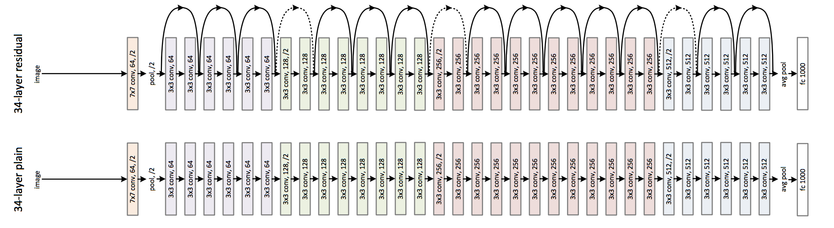
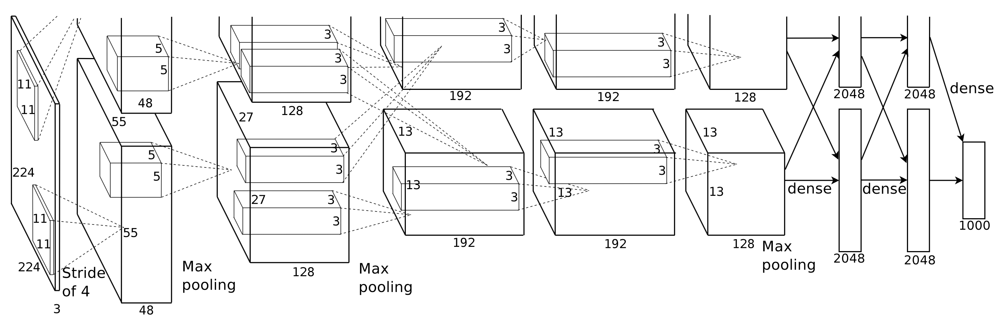
Network Architecture
AlexNet
[Krizhevsky et al., 2012]
ResNet
[He et al., 2015]

Slide 3
Neural Network
Input layer
Hidden layer
Output layer
x₁
w₁
w₂
x₂
y
w₃
x₃
Node, Neuron
Weight, Linkage
Multi-Layer Perceptron (MLP)

Slide 4
Multi-Layer Perceptron (MLP)

Slide 5
MLP : Input

Slide 6
MLP : Linkage
0.1
2.0
0.1x2.0 + 0.8x0.5 = 0.6
0.8
0.5

Slide 7
MLP : Activation
0.6
0.6
Rectified Linear Unit
(ReLU)

Slide 8
MLP : Output
”1”
0.1
”2”
0.1
”3”
0.8

Slide 9
Convolution
1 | 0 | 1
0 | 1 | 0
1 | 0 | 1
＊
Filter
Image
http://ufldl.stanford.edu/tutorial/supervised/FeatureExtractionUsingConvolution/
Extraction feature from images
Extract features the number of filters

Slide 10
Max Pooling
1 | 1 | 1 | 0
0 | 1 | 7 | 0
0 | 5 | 9 | 0
1 | 3 | 3 | 2
Pooling Size
Image feature
http://ufldl.stanford.edu/tutorial/supervised/Pooling/
Compress images
Robust against misalignment

Slide 11
1 | 2 | 3 | 0
0 | 1 | 2 | 3
3 | 0 | 1 | 2
2 | 3 | 0 | 1
1 | 2 | 3 | 0
0 | 1 | 2 | 3
3 | 0 | 1 | 2
2 | 3 | 0 | 1
2 | 0 | 1
0 | 1 | 2
1 | 0 | 2
2 | 0 | 1
0 | 1 | 2
1 | 0 | 2
15
15 | 16
6
＊
＊
1 | 2 | 3 | 0
0 | 1 | 2 | 3
3 | 0 | 1 | 2
2 | 3 | 0 | 1
2 | 0 | 1
0 | 1 | 2
1 | 0 | 2
1 | 2 | 3 | 0
0 | 1 | 2 | 3
3 | 0 | 1 | 2
2 | 3 | 0 | 1
15 | 16
2 | 0 | 1
0 | 1 | 2
1 | 0 | 2
＊
15 | 16
6 | 15
＊

Slide 12
1 | 2 | 3 | 0 | 2 | 3
0 | 1 | 2 | 3 | 1 | 2
3 | 0 | 1 | 2 | 0 | 1
2 | 3 | 0 | 1 | 2 | 0
1 | 0 | 1 | 3 | 2 | 0
0 | 2 | 1 | 0 | 3 | 1
2 | 0 | 1
0 | 1 | 2
1 | 0 | 2
15 | 16
6 | 15
＊

Slide 13
1 | 2 | 3 | 0
0 | 1 | 2 | 3
3 | 0 | 1 | 2
2 | 3 | 0 | 1
1 | 2 | 3 | 0
0 | 1 | 2 | 3
3 | 0 | 1 | 2
2 | 3 | 0 | 1
2
2 | 3
3 | 2
1 | 2 | 3 | 0
0 | 1 | 2 | 3
3 | 0 | 1 | 2
2 | 3 | 0 | 1
2 | 3
1 | 2 | 3 | 0
0 | 1 | 2 | 3
3 | 0 | 1 | 2
2 | 3 | 0 | 1
2 | 3
3

Slide 14
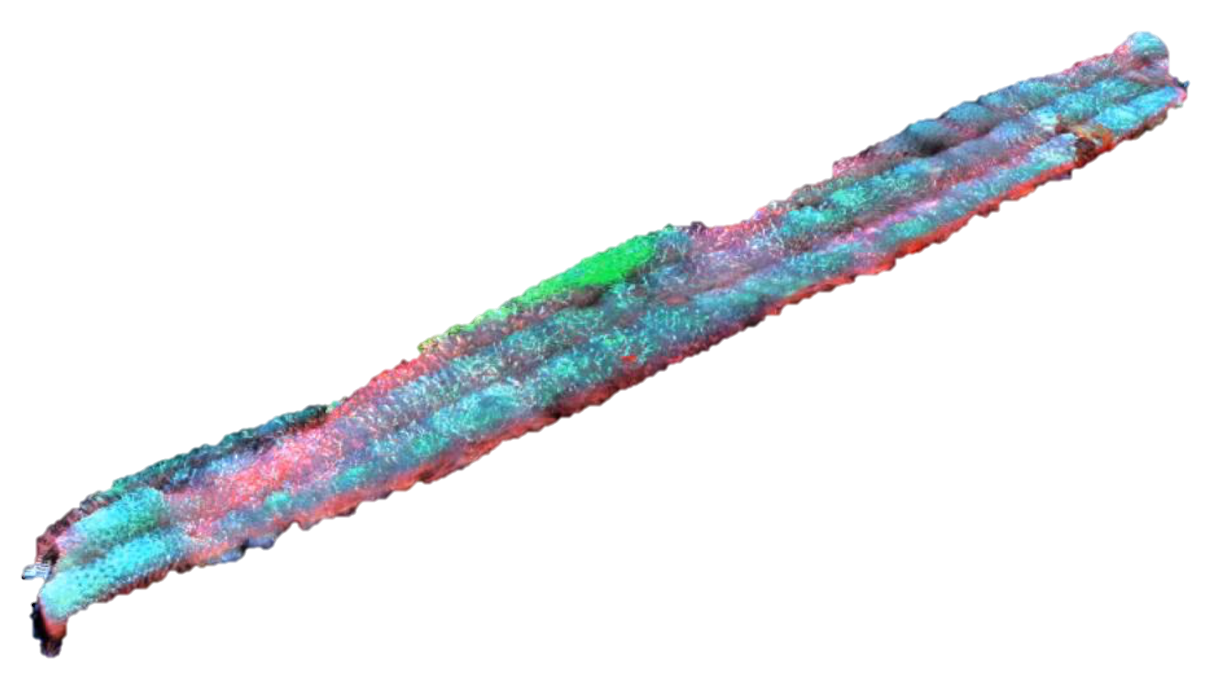

Slide 15
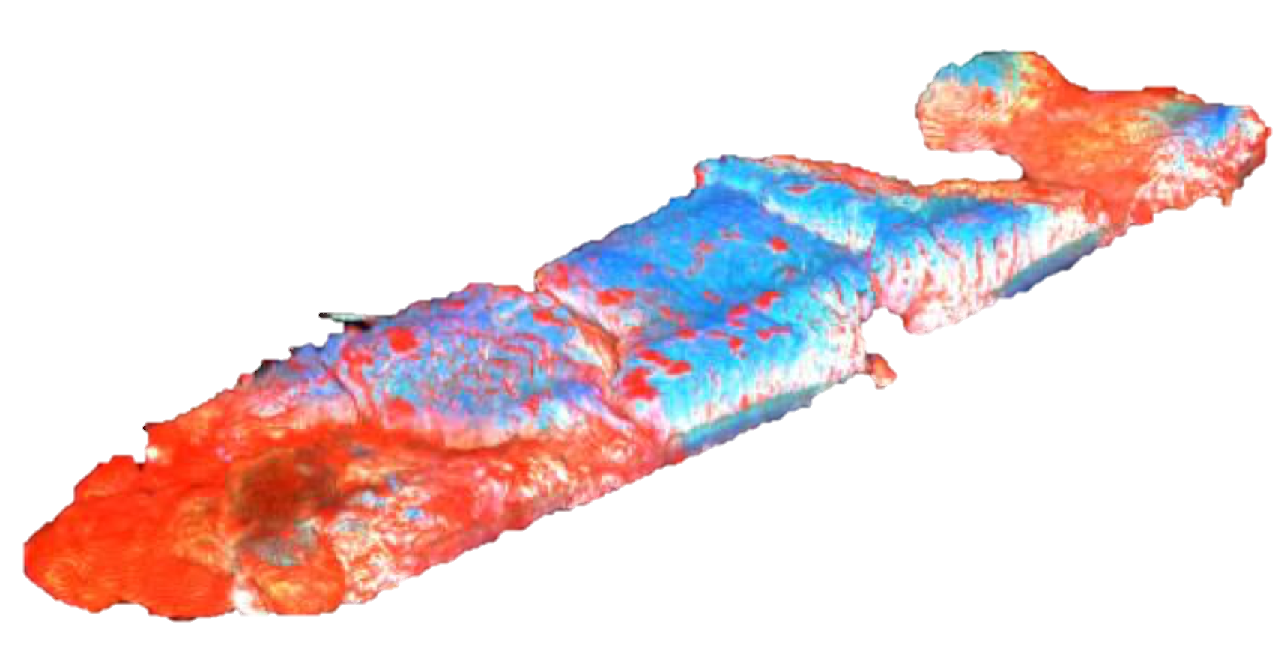

Slide 16
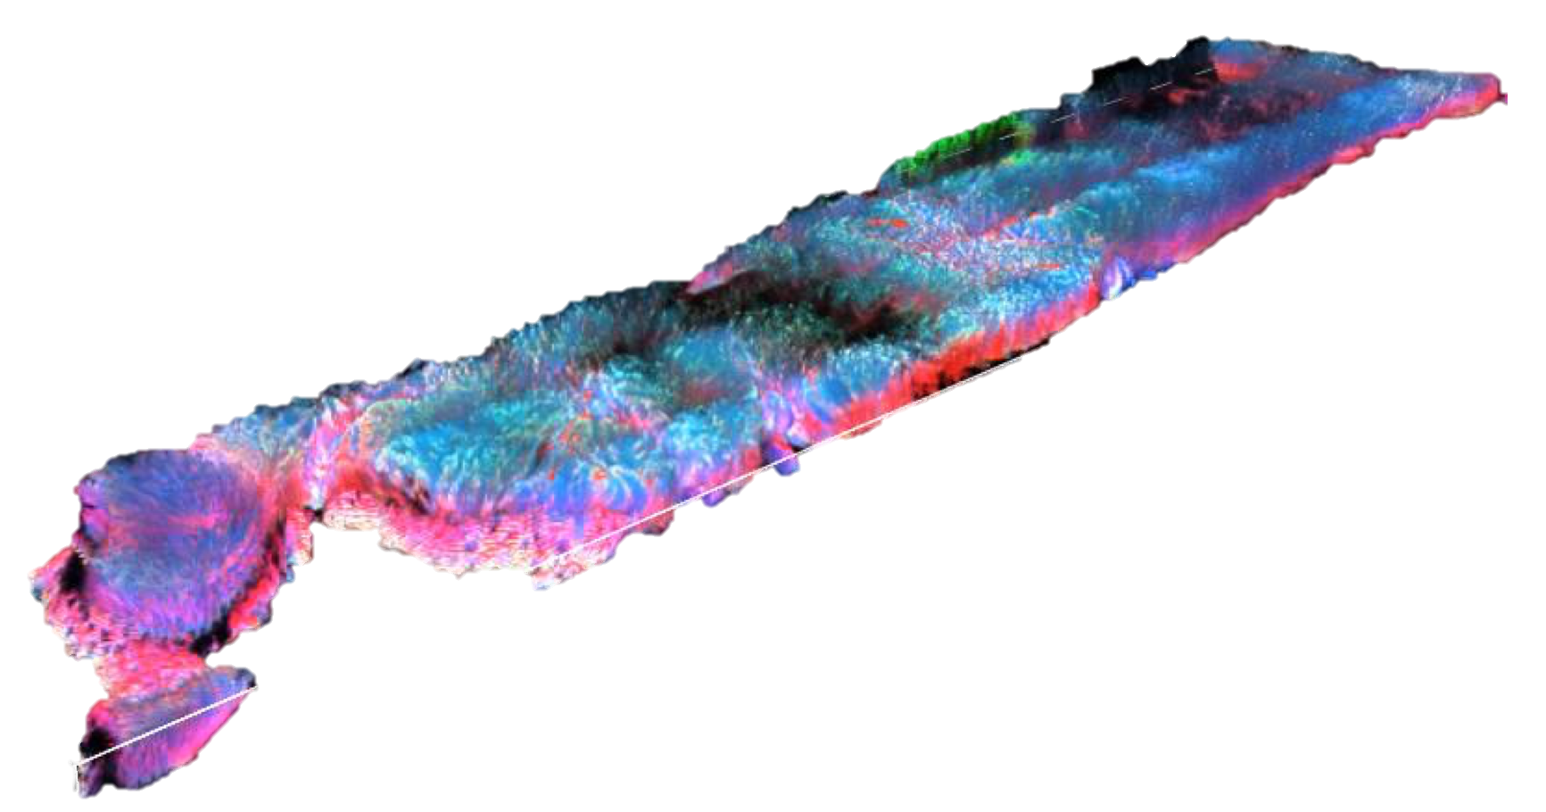

Slide 17
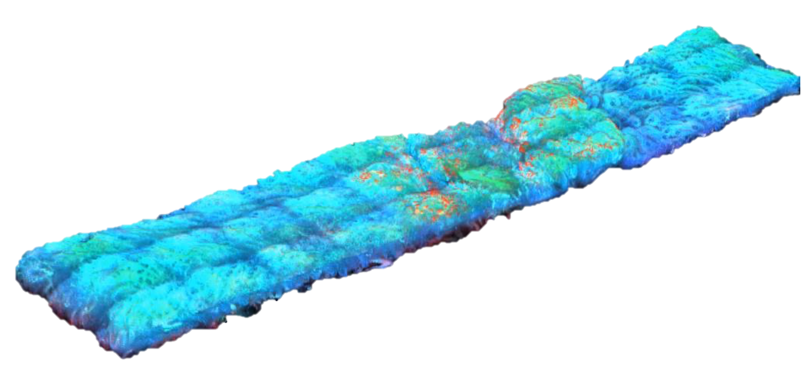

Slide 18
Convolutional Neural Network (CNN)
Convolution & Pooling
Fully Connected(FC)

Slide 19
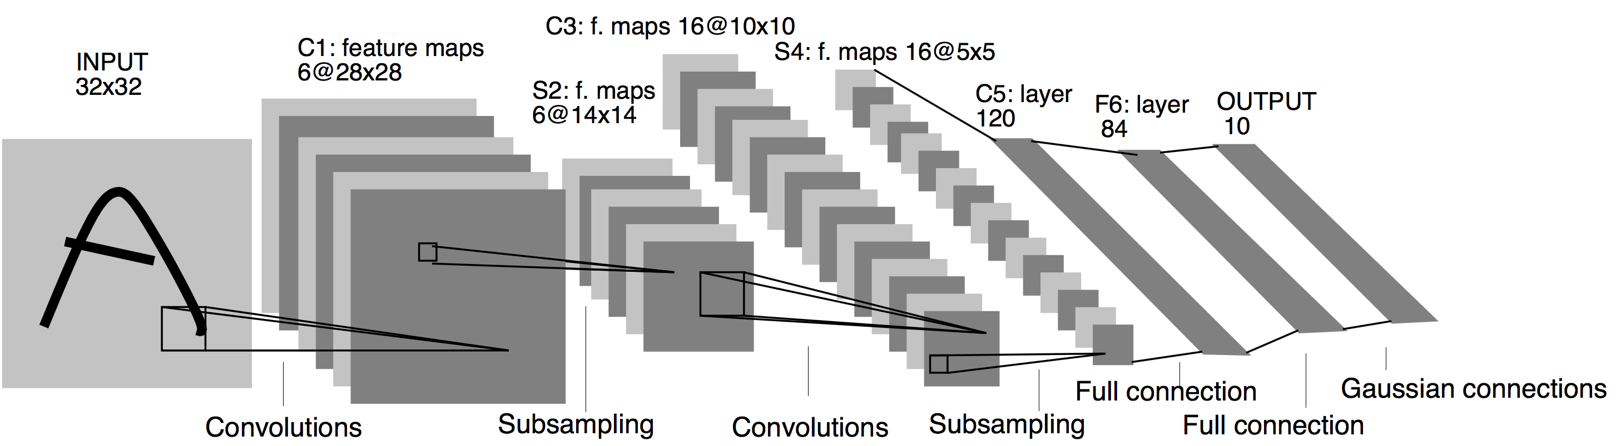
Neural Network Architecture
LeNet
[Lecun et al., 1998]
AlexNet
[Krizhevsky et al., 2012]

